Slide 1
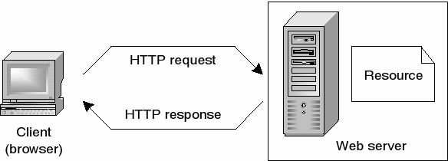
How does the web work?
Web servers and web browsers communicate via HTTP
HTTP ensures that all parts of the web page are delivered
Web browser decides how these items are displayed
The backbone of the web is the network of webservers across the world. These are really just computers that have a particular type of software running on them - software that knows how to speak the HTTP protocol and knows which information stored on the computer should be made accessible through the web.

Slide 2
What do you need to be a web developer?
To become a Web Developer, you should have an understanding of HTML, CSS, and JavaScript. It’s also recommended to learn about CSS and CSS frameworks. Developing these fundamental web development skills will give you the foundation and logic for communicating with programming languages.
How to become a Web Developer in five steps:
Learn web development fundamentals
Choose a development specialization
Learn key programming languages for web development
Work on projects to develop your Web Developer skills
Build a web development portfolio

Slide 3
What’s the Role of a web developer?
A Web Developer is responsible for the coding, design and layout of a website. As the role takes into consideration user experience and function, a certain level of both graphic design and computer programming is necessary. Once a website has been created, a Web Developer will generally assist with the maintenance and upkeep of the website.
In short, web developer create the visual representation of the World Wide Web
The web Developer role should cover :
Writing efficient code.
Creating websites/a website using standard HTML/CSS practices.
Working closely with web designers and programmers to produce the website.
Constant communication with other colleagues to develop and deploy their content and ensuring there is a clear establishment of what can be created.
Researching different software programs, maintaining software documentation.
Implementing contingency plans in case the website goes down.
Maintaining and expanding/enhancing the website once built.
Managing a team might also be part of the job role

